Slide 1
Homeschool 101
Presented by Hayley Peeler
JCHAI Homeschool Seminar
June 26th, 2026

Slide 2
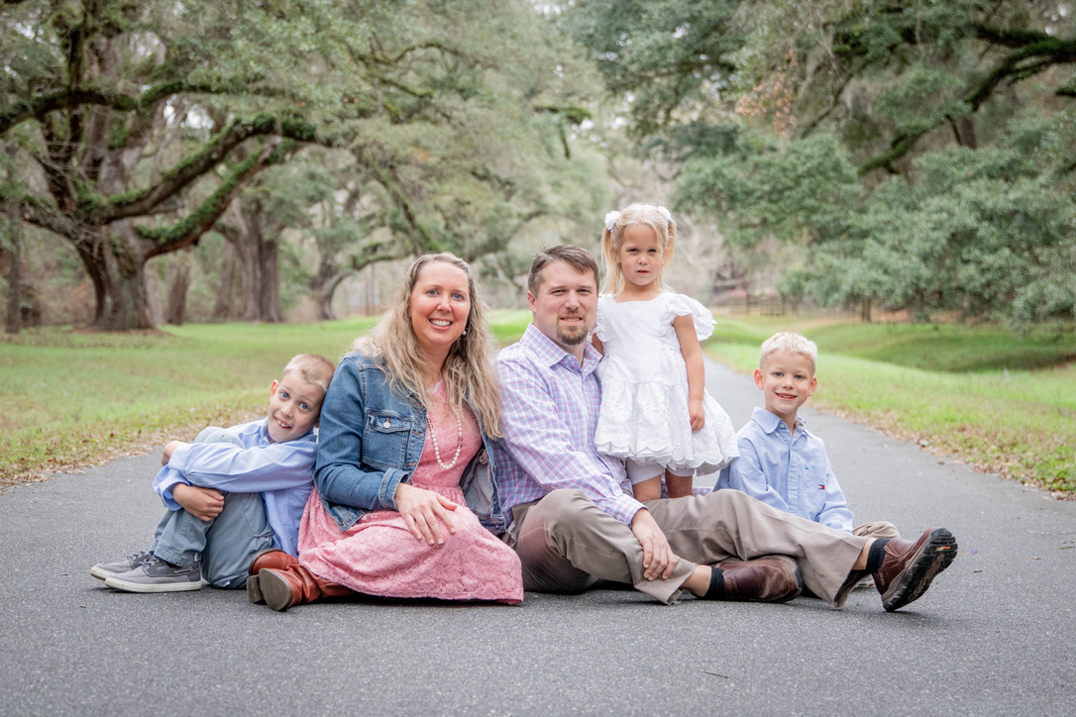

Introduction
About Me
Things We’ll Discuss:
Homeschool laws and options
The basics
Choosing curriculum
Scheduling
Your Own School Experience?

Slide 3
Let’s Start With a Little Game…
THIS OR THAT?
(SCHOOL EDITION)
WHICH WOULD YOU/YOUR CHILD PREFER?

Slide 4


THIS OR THAT?

Slide 5


THIS OR THAT?

Slide 6

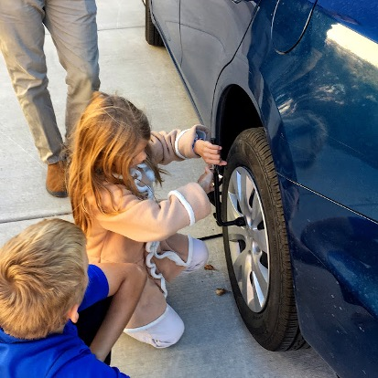
THIS OR THAT?

Slide 7


THIS OR THAT?

Slide 8

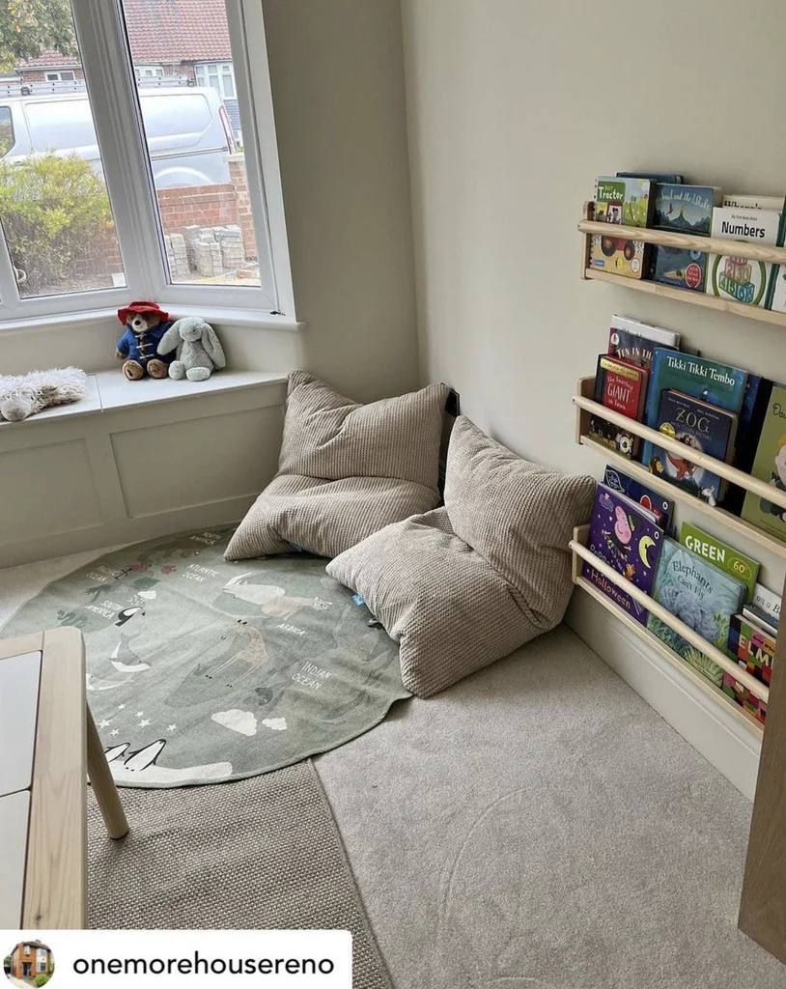
THIS OR THAT?

Slide 9
What Did You Choose? Why?
Comfortable
Engaging
Relevant
Personalized
This is what homeschooling can be!!

Slide 10
Fast Facts About Homeschooling
Homeschooling is the fastest growing mode of education in the U.S. (Currently 6.5 million children)
Studies show that homeschooled students outperform non-homeschooled students on standardized tests
Homeschooling is legal in all 50 U.S. states
  Each state has their own laws for homeschooling. We are only discussing Florida. If you move to another state, make sure you research their laws!
Benefits of homeschooling include: working at the child’s pace, fostering their interests, freedom to teach what you want, safety, morality, and increased family time

Slide 11
How to Get Started
Choose your homeschool route(next slide)
Consider your child’s age
  Will he/she be 6 or or before 02/01/2027? If yes, they MUST enroll in an educational program within 30 days of the start of public school
  Will he/she turn six after 02/01/2027? If yes, you have the option to wait another year before officially beginning school (but you can go ahead and start this year if you want, either with or without officially registering)
After registering, you have 30 days to officially begin instruction with your child
You can start homeschooling at ANY point in the school year if your child starts out at a private or public school – just submit your letter of intent

Slide 12
Three Routes of Homeschooling…
LETTER OF INTENT WITH COUNTY | PERSONALIZED EDUCATION PLAN (PEP) | UMBRELLA SCHOOL
Register with your local county school district (i.e. Leon, Jefferson, Taylor) – only done ONCE Only requires child’s name, birthdate, address, and parent name(s) Maintain a portfolio Provide annual proof of progress each year on or before the anniversary of your letter of intent Submit a letter of termination if you leave Florida or choose a different homeschool path *May be combined with the UA Scholarship (Unique Abilities) | Provides funding (About $9,000 per student) Apply by the deadline (already passed for 2025-2026) with all the necessary documents Terminate with the district or withdraw if need be Complete the requirements for accepting the funding Child MUST take a standardized test each year from a list of accepted tests Submit test scores and any other required follow-up documents | Provide child’s birth certificate and medical records Find a school that is listed as an accredited school in Florida Your child is legally a “private school” student Follow the rules and guidelines required by your umbrella school *Note* If the umbrella school ever closes or is audited, the school may be required to turn over all documents and records to the state

Slide 13
Homeschooling With the County (Letter of Intent)
Your portfolio (keep for two years) must include:
  Work samples that demonstrate “progress commensurate with ability”
  Titles of reading material (books, curriculum, magazines, newspapers, etc.)
  Log of educational activities (table of contents, calendar, lesson plan book, list of field trips and co-ops)
Provide Annual Proof of Progress
  Portfolio review by Florida certified teacher (most popular)
  Nationally norm-referenced standardized test
  Psychological evaluation
  State testing
  Any other agreed-upon method between parent and school district (FLVS transcripts are often accepted under this method)

Slide 14
Homeschool is NOT “School at Home”
SCHOOL | HOMESCHOOL
8AM-3PM, M-F, 180 days | Whenever you want! (No attendance or time requirements)
Transition time and waiting for others | Individualized and immediate attention
Tests and Grades | No tests or grades needed
Homework | No homework
Teaching to the middle | Teaching to your child
Teaching to the test | Fostering your child’s interests
Curriculum is driven by the textbooks | Curriculum is driven by the child
Students grouped by age | Many opportunities for multi-age interactions

Slide 15
Choosing a Curriculum
Online Computer-based May include videos Often tracks lessons and scores Not always ideal, especially for younger children | All-in-One Everything from one company Includes math, language arts, science, social studies, etc. | Hodge Podge Pick and choose from various companies May be needed to supplement where “all-in-one” companies are lacking May like different companies for different subjects
Open and Go Instructions tell you exactly what to say and do each day. Very little prep work on the parent’s part | Some Prep Required Parent may need to purchase specific items Prepare items in advance more common in younger grades, especially preschool | Subjects to consider: Math, Language Arts, Science, Social Studies, Handwriting, Phonics, Grammar, Geography, History, Bible, Art, Music, P.E.

Slide 16
Choosing and Using a Curriculum
Attend the next session
Research samples and reviews online
Move up or down a level if need be. Take placement tests if they are available
Change curriculums mid-year if need be
Don’t feel the need to finish every question on every page of every book! (Even schools don’t finish their books!)
Curriculum is not limited to textbooks – think about games, puzzles, apps, literature, field trips, co-ops, classes

Slide 17
Scheduling
For younger students (PreK – 2nd) focus on building a solid foundation of math, reading, and handwriting. Use non-fiction picture books to casually introduce science and social studies.
For upper elementary (3rd – 5th) start adding in an emphasis on writing. Rotate subjects like science, social studies, and grammar
Middle School: Students may start doing more of a regular schedule with doing most subjects most days
High School: Keep a transcript, follow the FL Graduation Requirements, administer your own diploma (Attend the High School Session if you’re at this point!)

Slide 18
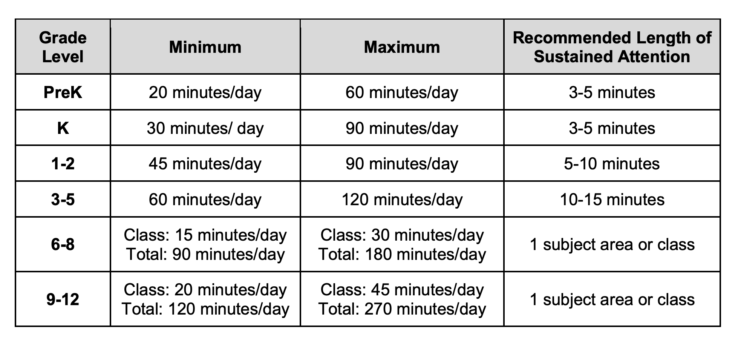
Scheduling

Slide 19
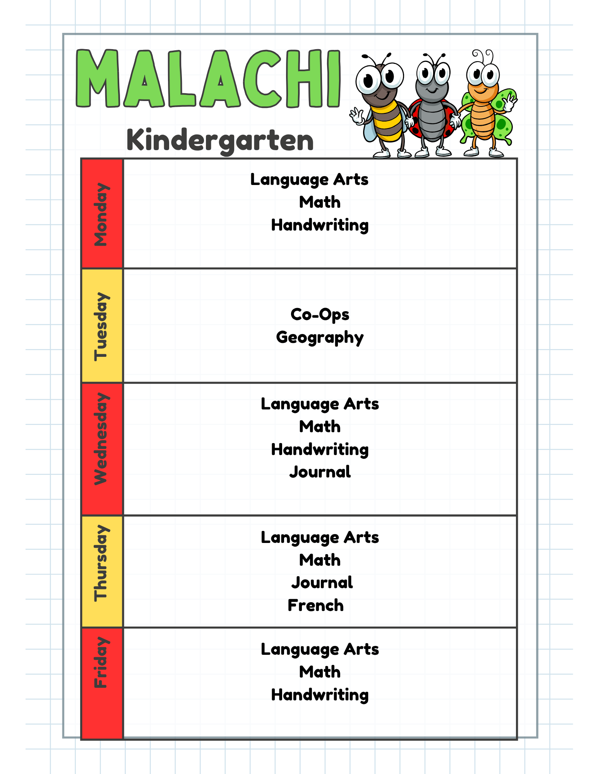
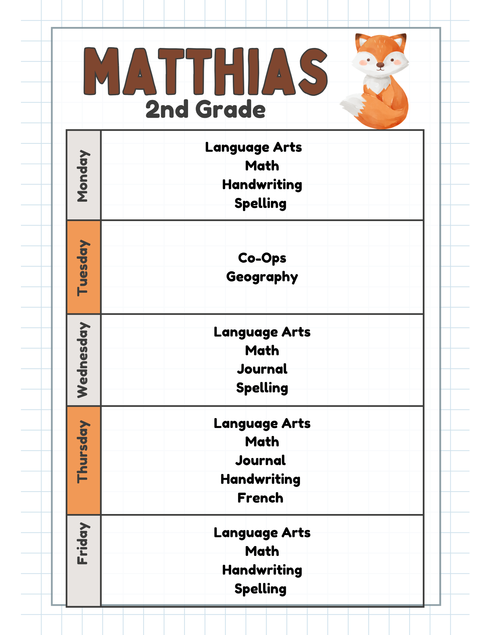

Slide 20
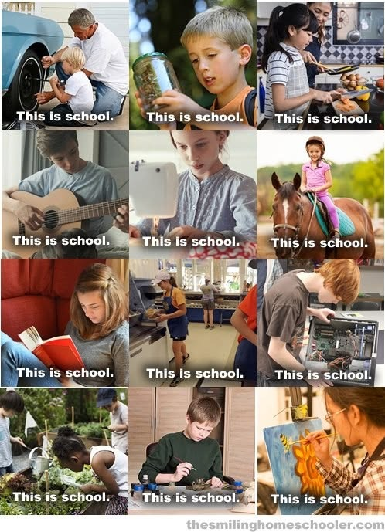
Keep the “home” in homeschool!
Schedule based on your family’s needs (vacations, work schedule, farm chores, new babies, helping sick family members…)
Make your children an integral part of the family
Let them explore their own interests
Create special traditions like poetry tea time, morning baskets, holiday celebrations, etc.

Slide 21


